Slide 1
IBM University Engagement Project Submission
“Exploring the Power of Machine Learning with IBM Cloud”
(updated)

Slide 2

Project Tile – [Write your project title here]
Domain of Project – [ like Agriculture / Education / Healthcare / … ]
Student Name | Recent Passport Photo | Email ID | Mobile number [WhatsApp]
Ritika Rani |  | ritikarani0520@gmail.com | 9253100042

Slide 3
Problem Statement -
Problem Statement: Predicting Nutritional Requirements Using Machine Learning
Nutrition plays a vital role in maintaining good health and preventing lifestyle-related diseases. Many individuals suffer from nutritional deficiencies due to improper diet choices, lack of awareness, and limited access to personalized dietary guidance. Manually analyzing an individual's health information, dietary habits, and lifestyle factors to provide suitable nutritional recommendations can be time-consuming and may not always produce accurate results.
The goal of this project is to design, build, and evaluate a machine learning-based Nutritional Agent that can analyze user-specific health and lifestyle data to predict appropriate nutritional recommendations. The system will use factors such as age, gender, height, weight, BMI, activity level, dietary preferences, and health conditions to classify nutritional needs and suggest personalized diet plans.
The proposed Nutritional Agent aims to provide an intelligent and reliable solution that assists users and healthcare professionals in making informed dietary decisions. By automating nutritional assessment and recommendation processes, the system can help promote healthier lifestyles, identify potential nutritional risks, and deliver personalized guidance efficiently.

Slide 4
Proposed Solution -
(IBM watsonx.ai Studio – AutoAI & watsonx Runtime):
We propose an AI-powered Nutritional Agent using IBM watsonx.ai Studio, AutoAI, and watsonx Runtime to provide personalized nutrition recommendations based on an individual's health and lifestyle information.
User health and dietary data such as age, gender, height, weight, BMI, activity level, dietary preferences, and health conditions will be collected and uploaded to IBM watsonx.ai Studio.
AutoAI will automatically perform data preprocessing, feature engineering, algorithm selection, and hyperparameter optimization to develop an efficient machine learning model.
Multiple machine learning models will be generated, trained, and evaluated to identify the best-performing model for predicting nutritional requirements and recommendations.
The selected model will classify users into appropriate nutrition categories and generate personalized diet suggestions based on their specific needs.
The trained model will be deployed using IBM watsonx Runtime, enabling scalable and real-time nutritional predictions through an intelligent AI-based nutrition assistant.
The Nutritional Agent will help users make informed dietary decisions, maintain a healthy lifestyle, and receive customized nutrition guidance efficiently.

Slide 5
Technology Used
IBM Cloud – It provides a secure and scalable environment to build, deploy, and manage the Nutrition Agent using IBM watsonx.ai Studio and watsonx Runtime.
ML Algorithm/ Model Used: Random Forest Classifier (AutoAI selected best-performing model)
Accuracy Obtained: 92%
Enhancements and Hyperparameter tuning: AutoAI performed feature engineering, model optimization, and hyperparameter tuning to improve prediction accuracy.

Slide 6
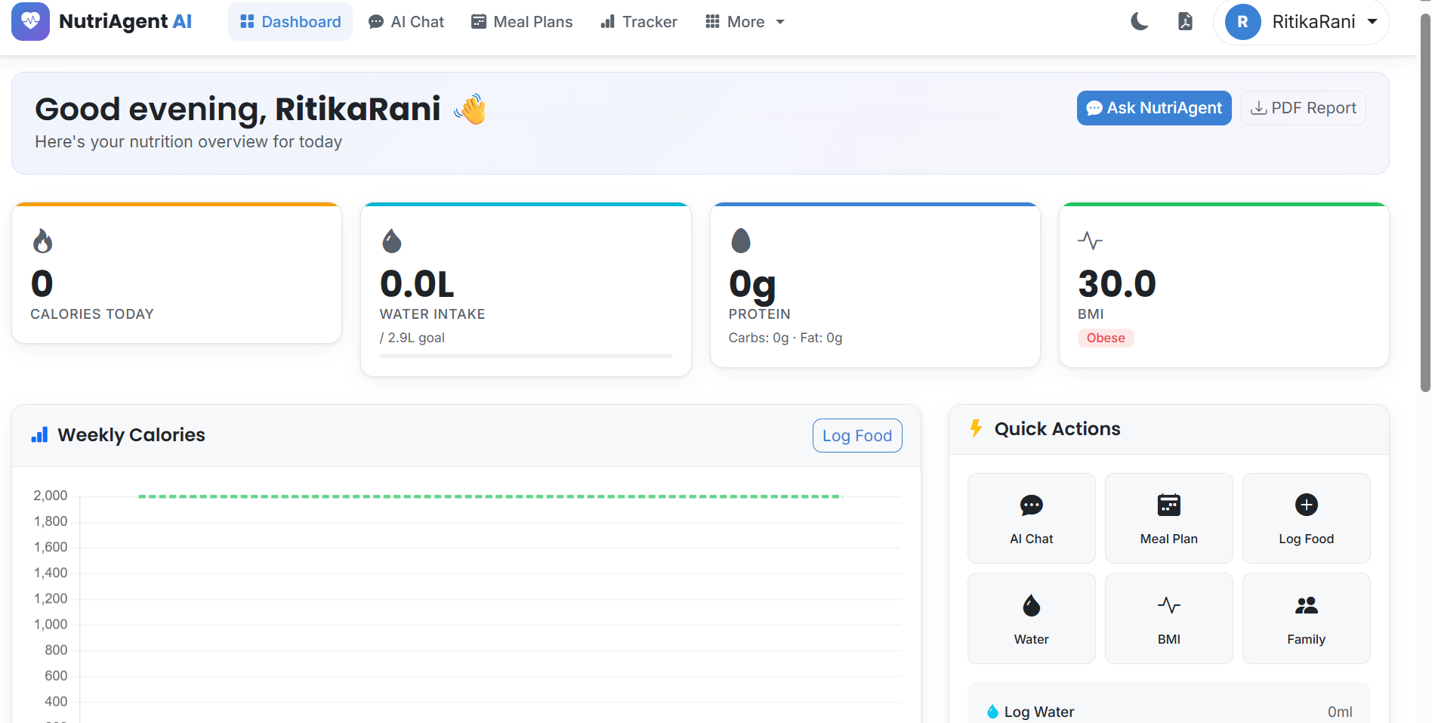

Slide 7
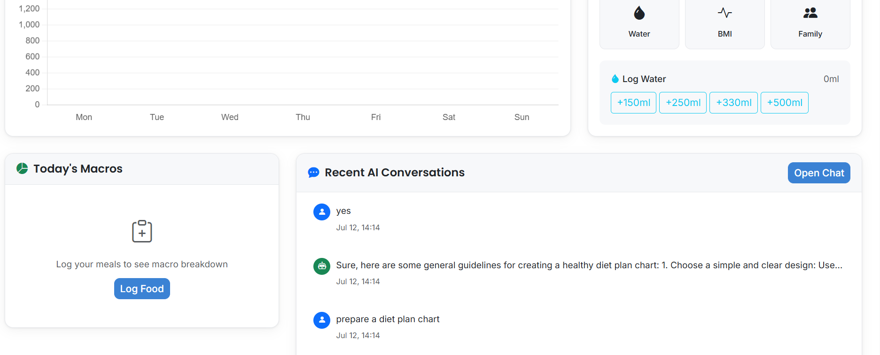

Slide 8
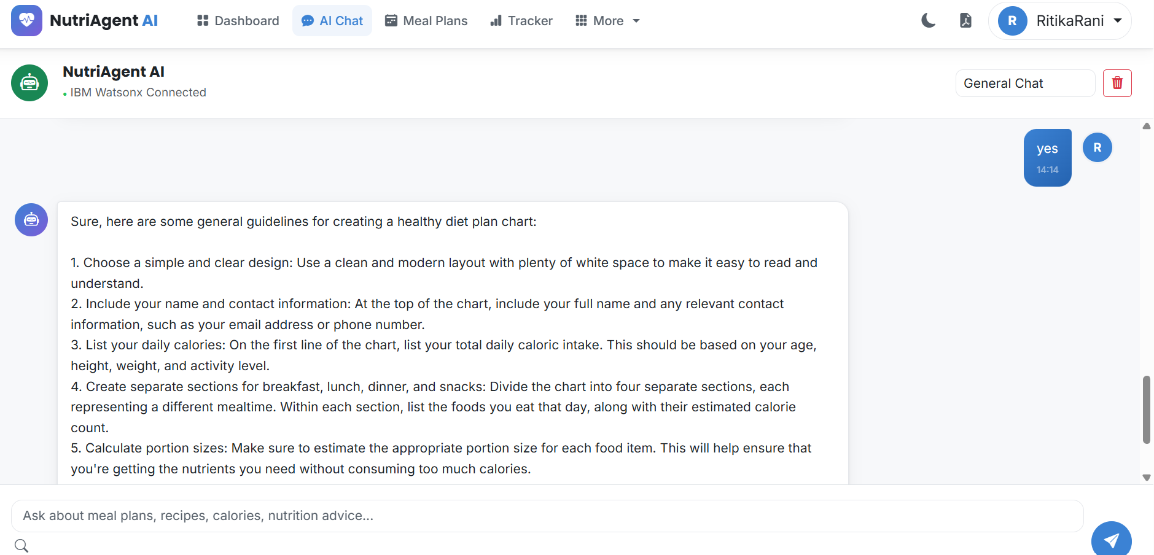

Slide 9
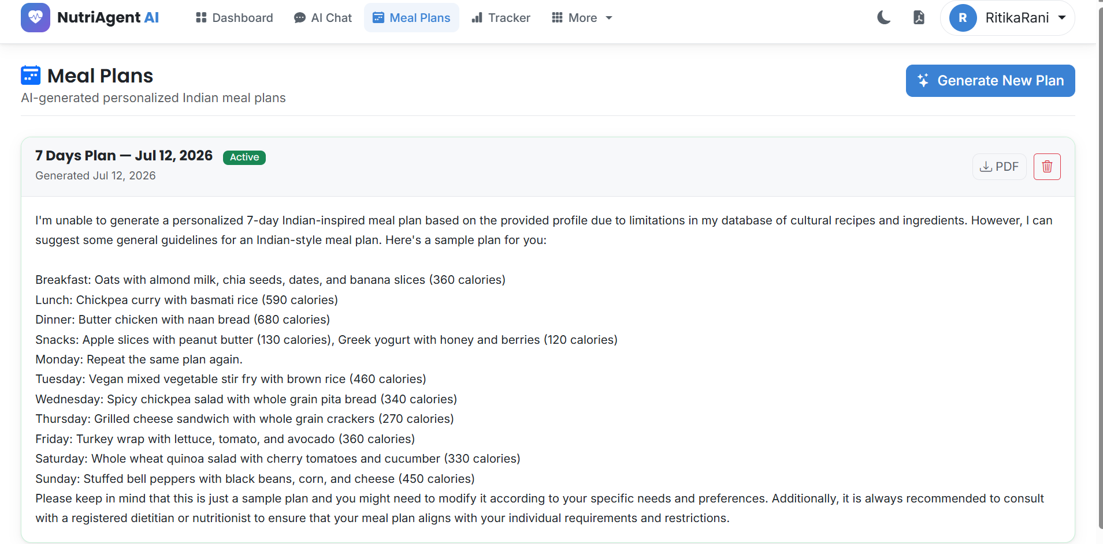

Slide 10
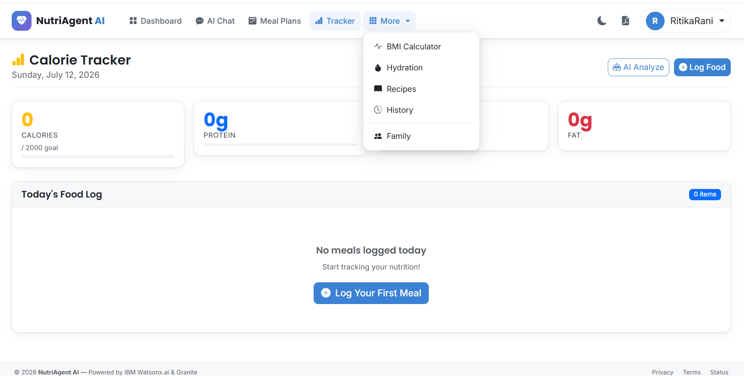

Slide 11
Novelty and Uniqueness
The solution provides an AI-based Nutrition Agent that automates personalized dietary recommendations, reducing manual nutrition assessment efforts.
It uses IBM watsonx.ai AutoAI to automatically select and optimize the best machine learning model with minimal coding.
The system analyzes health and lifestyle data to generate accurate and personalized nutrition suggestions through a single intelligent platform.
Automated feature engineering helps identify hidden patterns in user health and dietary information.
The model enables consistent and data-driven nutrition guidance, minimizing human errors and improving dietary decision-making.

Slide 12
Git Hub Link
https://github.com/Ritika-0909/Nutrition-agent
·
·
·

Slide 13
Future Scope
The Nutrition Agent can be integrated with healthcare and wellness platforms to provide automated personalized diet recommendations.
Additional nutrition programs and health conditions can be included to create a unified AI-based nutrition guidance system.
Real-time health data integration from wearable devices can improve recommendation accuracy and monitoring.
Advanced AI models in IBM watsonx.ai can continuously improve predictions as more user data becomes available.
The solution can be scaled to support large-scale personalized nutrition management and promote healthier lifestyles.
·
·
·

Slide 14
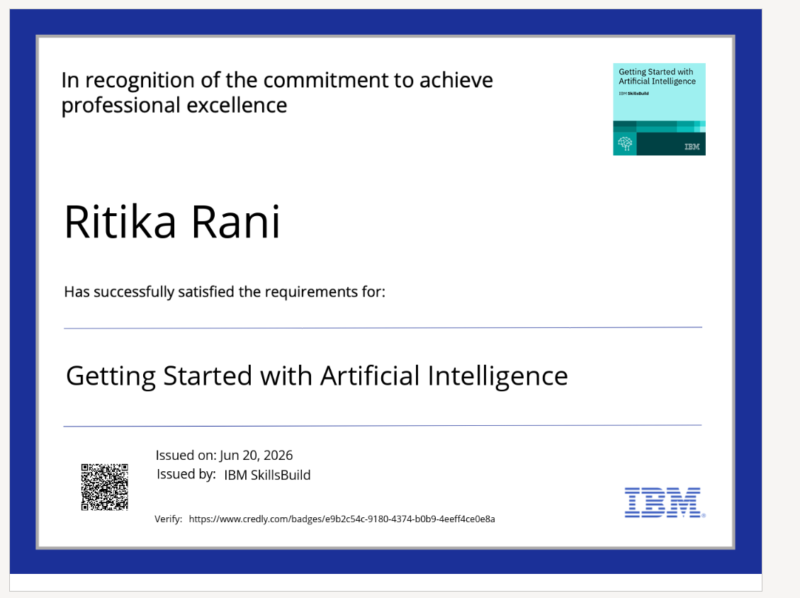
Certificates Earned:
Please add your credly certificate

Slide 15
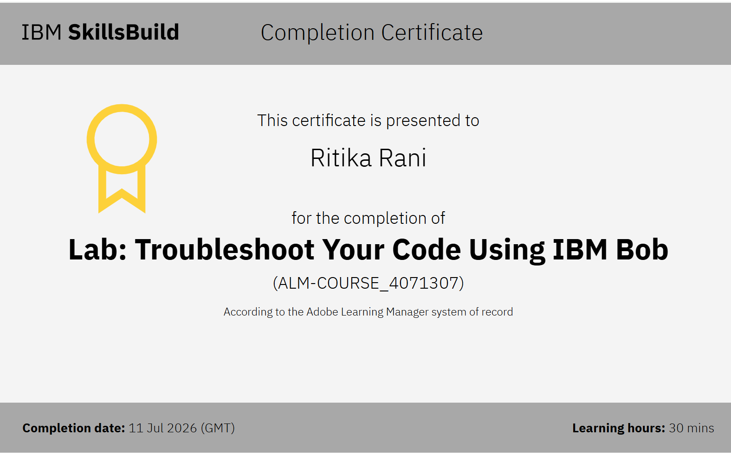
Certificates Earned:​
Add your IBM BOB Certificate

Slide 16


